Slide 1

SD
DS
M
A Shallow Dive into Mathematics for
Data Science
(Session 1)

Slide 2
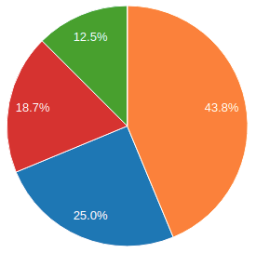
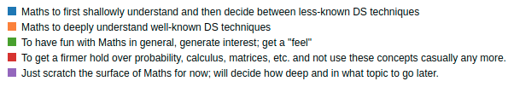
Polly@Slack: Results

Slide 3
Polly@Slack: Results
50 mins

Slide 4
Polly@Slack: Results
50 mins
Fun! 6.25 mins

Slide 5
Polly@Slack: Results
50 mins
Fun! 6.25 mins
Firmer hold 9.35 mins

Slide 6
Polly@Slack: Results
50 mins
Fun! 6.25 mins
Firmer hold 9.35 mins
Deep well-known DS 21.9 mins

Slide 7
Polly@Slack: Results
50 mins
Fun! 6.25 mins
Firmer hold 9.35 mins
Deep well-known DS 21.9 mins
Shallow new DS 12.5 mins

Slide 8
Polly@Slack: Results
50 mins
Fun! 7 mins
Firmer hold 10 mins
Deep well-known DS 21 mins
Shallow new DS 12 mins

Slide 9
Maths for Fun

Slide 10
Maths for Fun
Part I
The Logical Origins!
(logical != chronological)

Slide 11
Logic and Paradoxes
Statement / Proposition: Can be answered by True/False
Examples of non-statements?
AND (^), OR (v), NOT (~), IF-THEN (⇒), IF-AND-ONLY-IF (⇔)
Boolean Algebra
Truth tables
Liar’s paradox
Barber’s paradox
Heaven/Hell puzzle

Slide 12
Sets
Set: collection of objects!
Well-defined?
Logic and sets:
Russell’s Paradox: S = {X | X not in X} S in S? S not in S?
Logic | Set Theory
Statement P | Set S_{P} = {x | P(x)}
AND (^) | Intersection
OR (v) | Union
NOT (~) | Complementation
If-Then (⇒) | Subset
If-and-only-if (⇔) | Equality

Slide 13
Maths for Fun
Part II
The Evolution!

Slide 14
Numbers: Trivial jumps
Natural numbers 0 ⇔ {} 1 ⇔ {{}} ⇔ {0} 2 ⇔ {{}, {{}}} ⇔ {0, 1} 3 ⇔ {{}, {{}}, {{}, {{}}}} ⇔ {0, 1, 2}
Operations: ++, +, -, x, /
Subtraction ⇒ Need for negatives: Jump to Integers
Division ⇒ Need for fractions: Jump to Rational numbers

Slide 15
Sequences, limits, real numbers
Sequences and limits of sequences
Infinite, infinitesimal
1/0 vs 0/0? 1 - 1 + 1 - 1 + 1 - 1 + 1 … = ? 1 + (½) + (¼) + (⅛) + … = ? 1 + 2 + 4 + 8 + … = ?
Limits ⇒ first non-trivial jump ⇒ Real numbers, irrational numbers: π, √2, etc.
Need for roots of negatives: Jump to Complex numbers

Slide 16
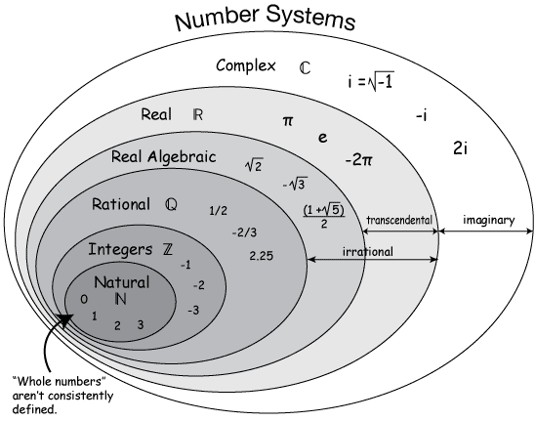

Slide 17
A Firmer Hold
Part III
The Disambiguation!

Slide 18
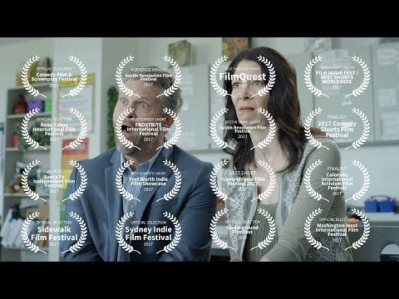

Slide 19
A Firmer Hold
Part IV
The Definition!

Slide 20
Intuition vs Rigor: Definitions
Maths is formal, not casual!
Not open to interpretation unless grasped!
It’s a language; cannot be abused
Attention to detail: each piece of notation, symbol
Definitions are the holy grail of Mathematics

Slide 21
Axioms, Theorems, Lemmas, Claims, Proofs
Axiom: A Logical Assumption
Theorem: A statement deducted from Axiom
Lemma: A smaller Theorem
Claim: A smaller Lemma
Proof: Argument to prove the above three:
Induction
Deduction
Contradiction
Construction
Proofs are the next holy grail!

Slide 22
Example: Probability
Random Experiment: Experiment could be repeated:
All possible outcomes known in advance
Exact outcome not known in advance
Sample Space: All possible outcomes of random experiment, 𝛺
Event: A subset of the sample space
Event Space: Power set of the sample space, 2^{𝛺}
Probability: Function, P: 2^{𝛺}→[0,1] such that:
P(A) >= 0 for all A
P(𝛺) = 1
P(A∪B) = P(A) + P(B) if A∩B = {}

Slide 23
Lemma: P(A∪B) = P(A) + P(B) - P(A∩B)

Slide 24
Theorem: The Inclusion-Exclusion
P(A₁ ∪ A₂∪ … ∪ A_{n}) =
P(A₁) + P(A₂) + … + P(A_{n})
- P(A₁∩A₂) - P(A₁∩A₃) - … - P(A_{n-1} ∩ A_{n})
+ …
+ (-1)^{n-1} P(A₁ ∩ A₂ ∩ … ∩ A_{n})

Slide 25
Deep, well-known DS
Part V
The Ammunition!

Slide 26
Well-known Data Science
Represent data: Matrices, Probability
Explore data: Statistics
Summarize data: Statistics, Matrices
Dissect data: Statistics, Matrices
Iterate through data: Optimization
Build algorithms: Prove convergence
Evaluate algorithms: Statistics

Slide 27
Linear Algebra, Matrices
Definitions: Vector space & Transformations
Real vectors & Matrices
Matrix operations: Add, Multiply, Invert
Linear combinations, Linear independence, Span, Basis
Column-space, Rank of a matrix
Eigenvalues, Eigenvectors
Interesting properties of matrices
Singular Value Decomposition
Other decompositions: Triangularization, Diagonalization, NMF

Slide 28
Probability, Random Variables, Statistics
Probability: Combinatorial, Frequentist, Bayesian
PDF, CDF, Conditional Probability, Bayes’ Theorem
Random variables, Random vectors
Expectation, Variance, Moment of random variables
Covariance/Correlation of random vectors
Discrete/Continuous Random Variables
Joint Probability, Marginal Probability
Descriptive Statistics, Estimation, Inference
Hypothesis Testing, Decision Theory

Slide 29
Calculus, Computational Optimization
Sequences, Limits, Convergence, Limit points
Open, Closed sets
Functions, Limits, Continuity,
Gradient, Hessian
Taylor’s series, First/second order necessary/sufficient conditions
1-D: Golden-section, Newton’s
Convex optimization: Global minima = local minima
Unconstrained optimization
Constrained optimization
Gradient descent

Slide 30
Deep, well-known DS
Part VI
The Application!

Slide 31
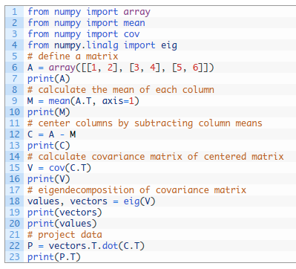
Dimensionality Reduction: PCA
Data Matrix: X
Covariance Matrix S
Eigenvalues of S
Pick top k

Slide 32
Classification: Naive Bayes Classifier
c: class, x: pattern, f: feature P(class | pattern) = P(pattern | class) . P(class) / P(pattern) = Z * P(f₁, f₂, …, f_{n} | c) * P(c) = Z * P(f₁ | c) * P(f₂ | c) *…* P(f_{n} | c) * P(c)
P(f | c) = P(feature | class) = s(f, c) / s(c) P(c) = P(class) = m(c) / m
Predicted class = class*: class* = argmin_{c1, c2, …, ck} P(class* | pattern)
Feature importances: P(f | c) or P(c | f) or P(f, c)

Slide 33
Clustering: k-Means
Clustering NP hard
Distance
Metric
Convergence
kmeans++, kmeans||

Slide 34
Shallow, new DS
Part VII
The Extension!

Slide 35
Eigenvector Centrality in Hypergraphs
Eigenvector centrality in Graphs? + Hypergraphs?
Eigenvector centrality? + Graphs? + Hypergraphs?
Eigenvectors? + Centrality in Graphs? + Hypergraphs?

Slide 36

Centrality in Graphs
Graph: (V, E) - Vertices, Edges
Centrality: Importance of each node in a network
A: Adjacency matrix
x: centrality vector
Eigenvector centrality:
Neighbors of central nodes are central
Ax = λx

Slide 37
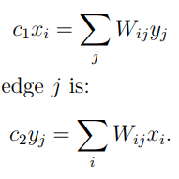
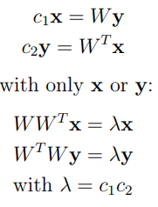
Hypergraphs: Generalization of Graphs
Edge size of more than two is possible -- Hyperedges
Eigenvector centrality extensions: W: incidence matrix
Nodes of central hyperedges are central
Hyperedges over central nodes are central ⇒

Slide 38
Thanks!

